Slide 1
Photomicrographs of Plant foods
Lettuce: Green and Red Leaf
Permission to reproduce original photomicrographs used to make this collection may be obtained from
Dr. David O. Norris at
david.norris@colorado.edu

Slide 2
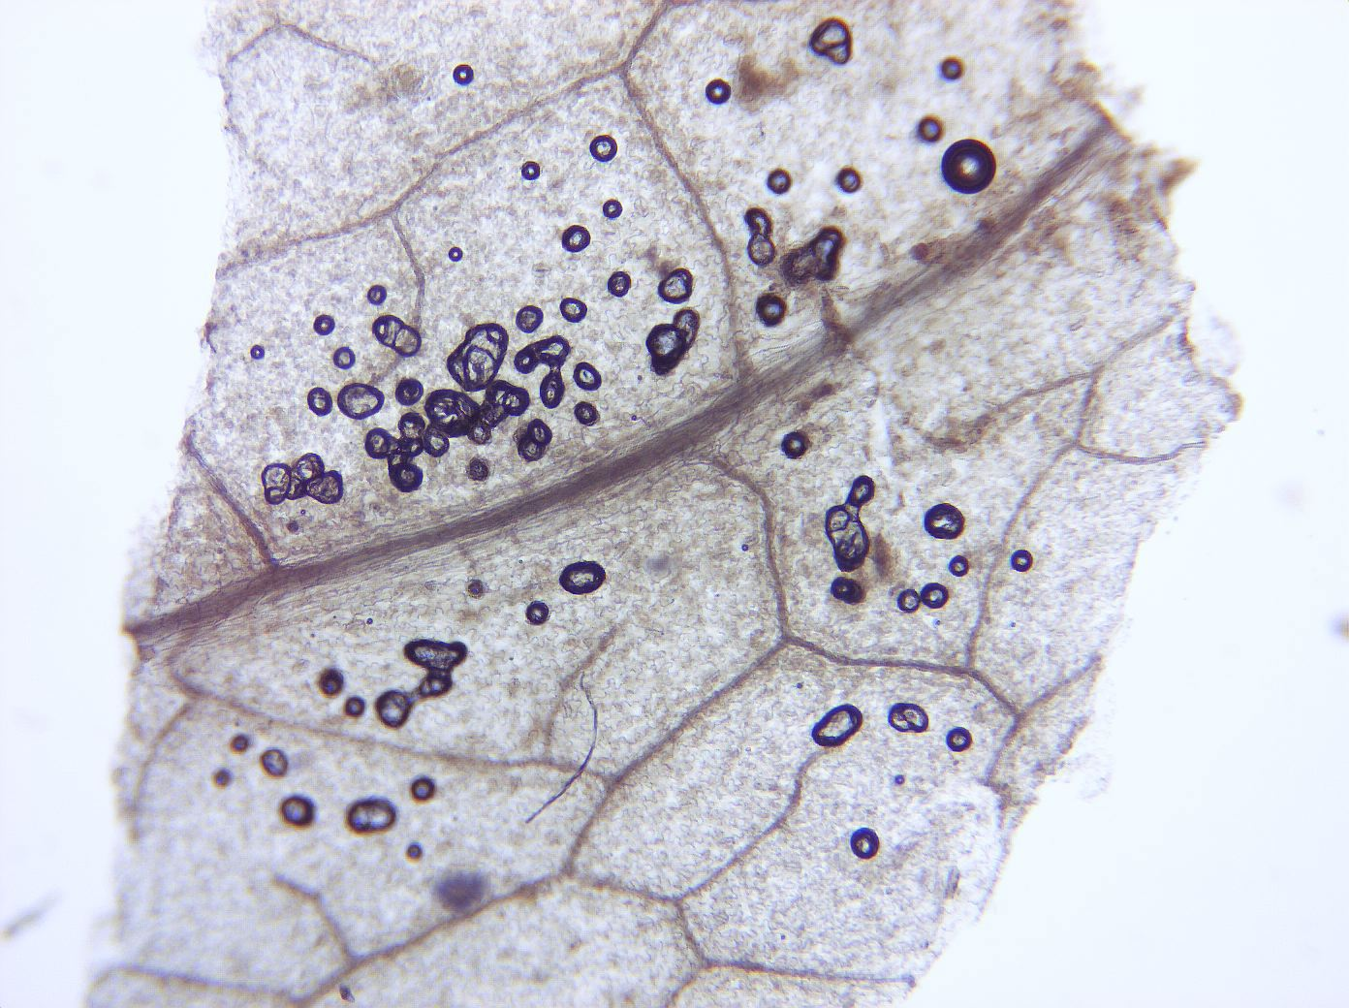
Notes:
278. Lactuca spp. L. Lettuce, green (many varieties). Leaf surface showing venation pattern, 4X. Green pigment leached out. Air bubbles (e.g., arrows) are artifacts of slide preparation.

Slide 3
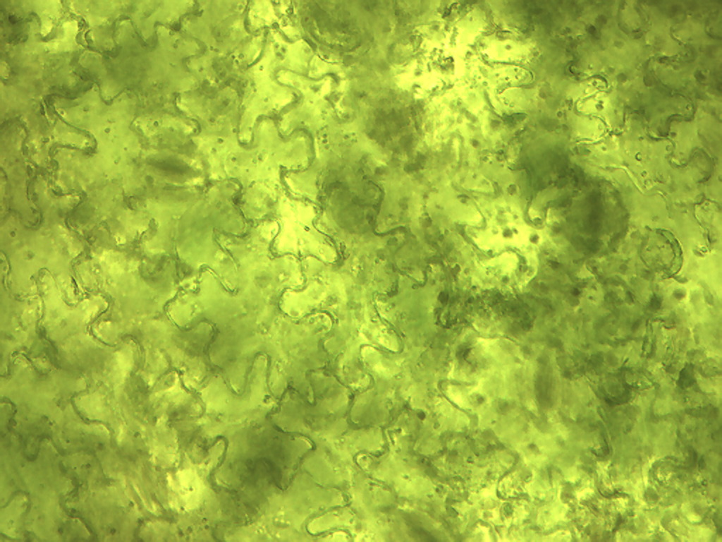
Notes:
279. Lettuce, green. Leaf epidermal cells, 25X.

Slide 4
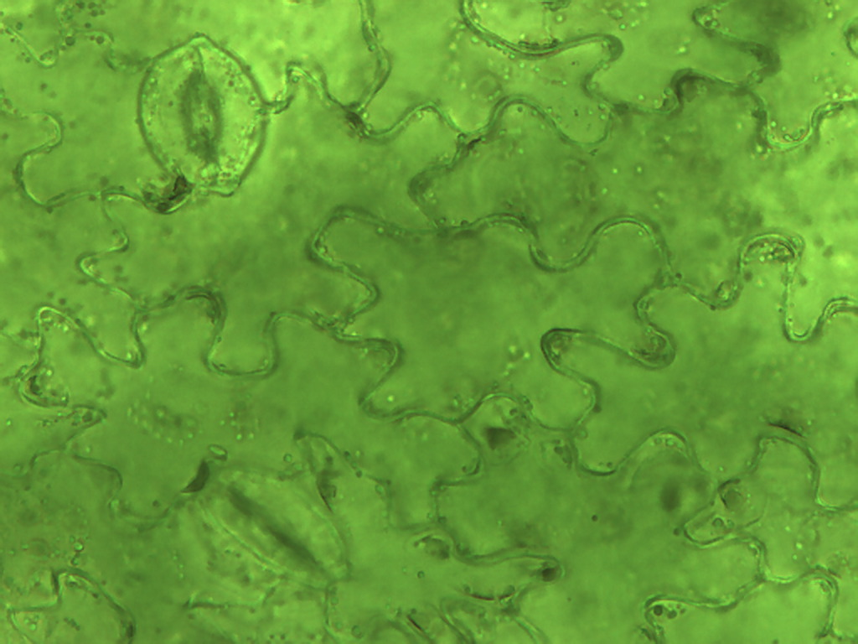
Notes:
280. Lettuce, green. Epidermal cells with stomate (arrow), 40X

Slide 5
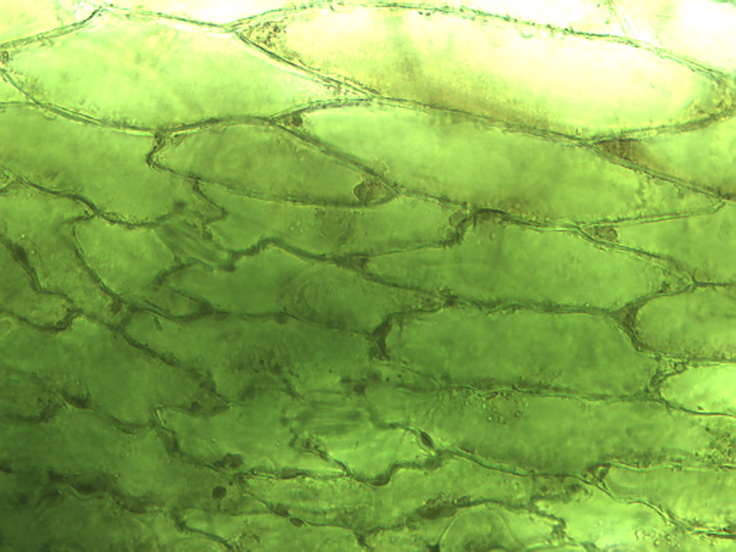
Notes:
281. Lettuce, green. Leaf epidermis, transitioning from highly lobed cells to more elongate cells, 25X.

Slide 6
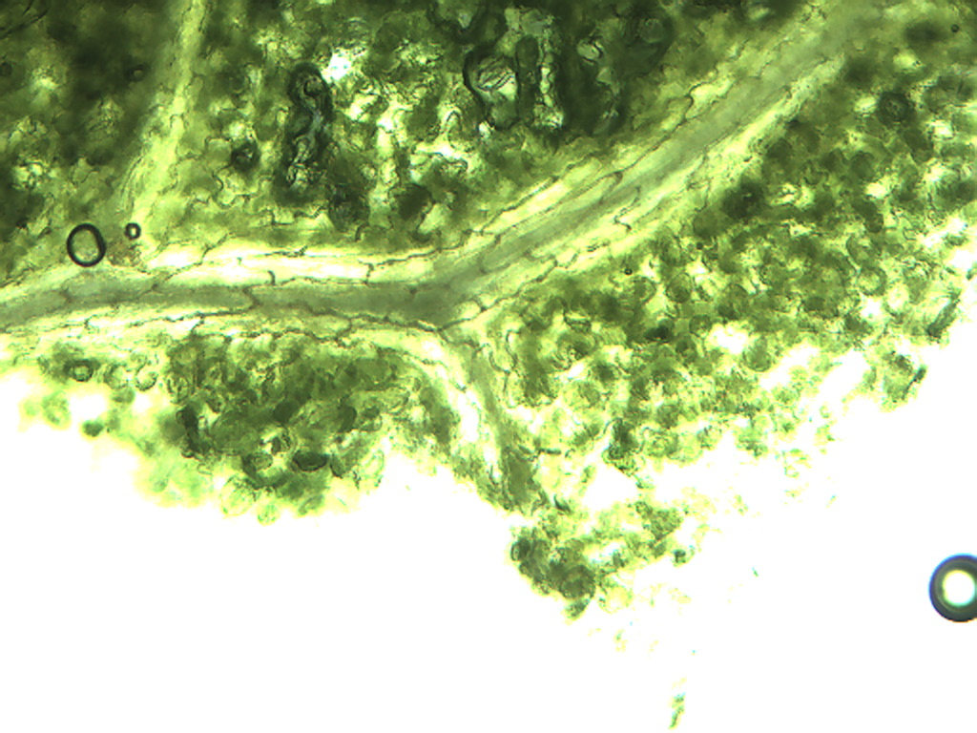
Notes:
282. Lettuce, green. Leaf xylem cells associated leaf veins, 10X.

Slide 7
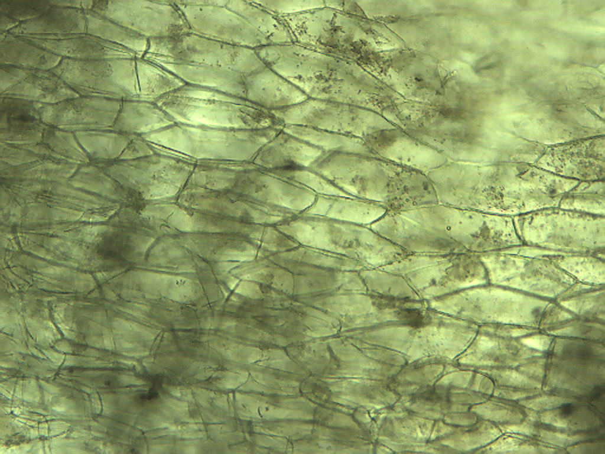
Notes:
283. Lettuce, green. Leaf epidermal cells in colorless base of leaf, 10X. Note absence of stomata..

Slide 8
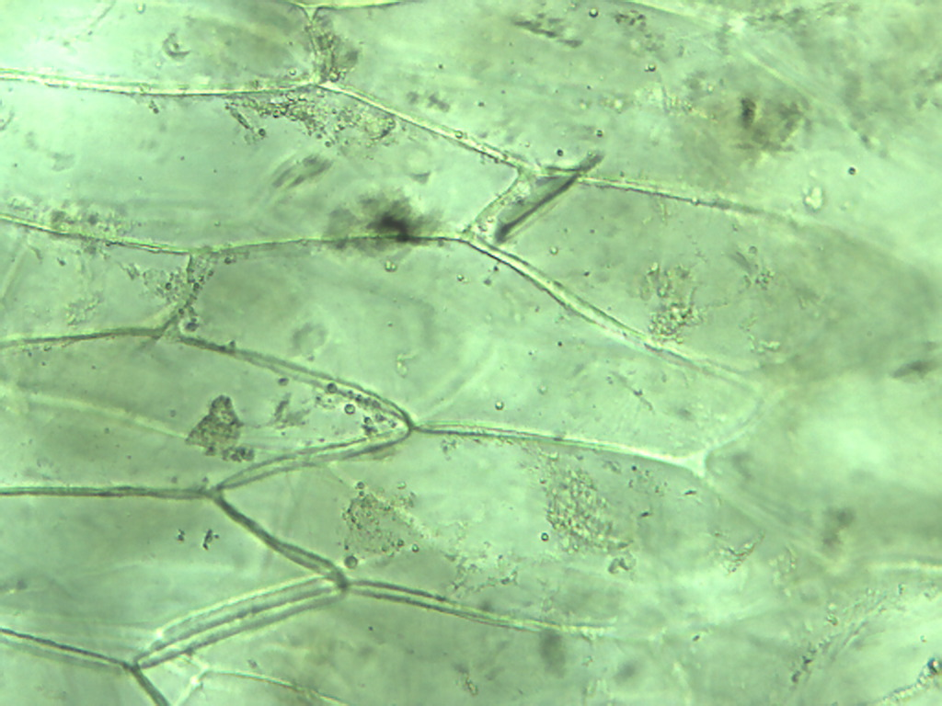
Notes:
284. Lettuce, green. Leaf epidermal cells in colorless base of leaf, 25X.

Slide 9
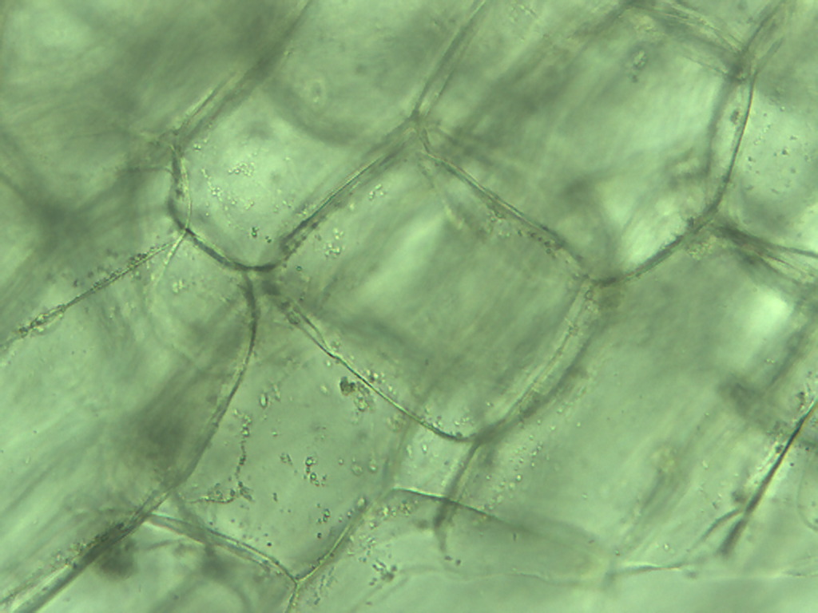
Notes:
285. Lettuce, green. Leaf: cuboidal non-photosynthetic parenchymal cells in colorless base of leaf, 25X.

Slide 10
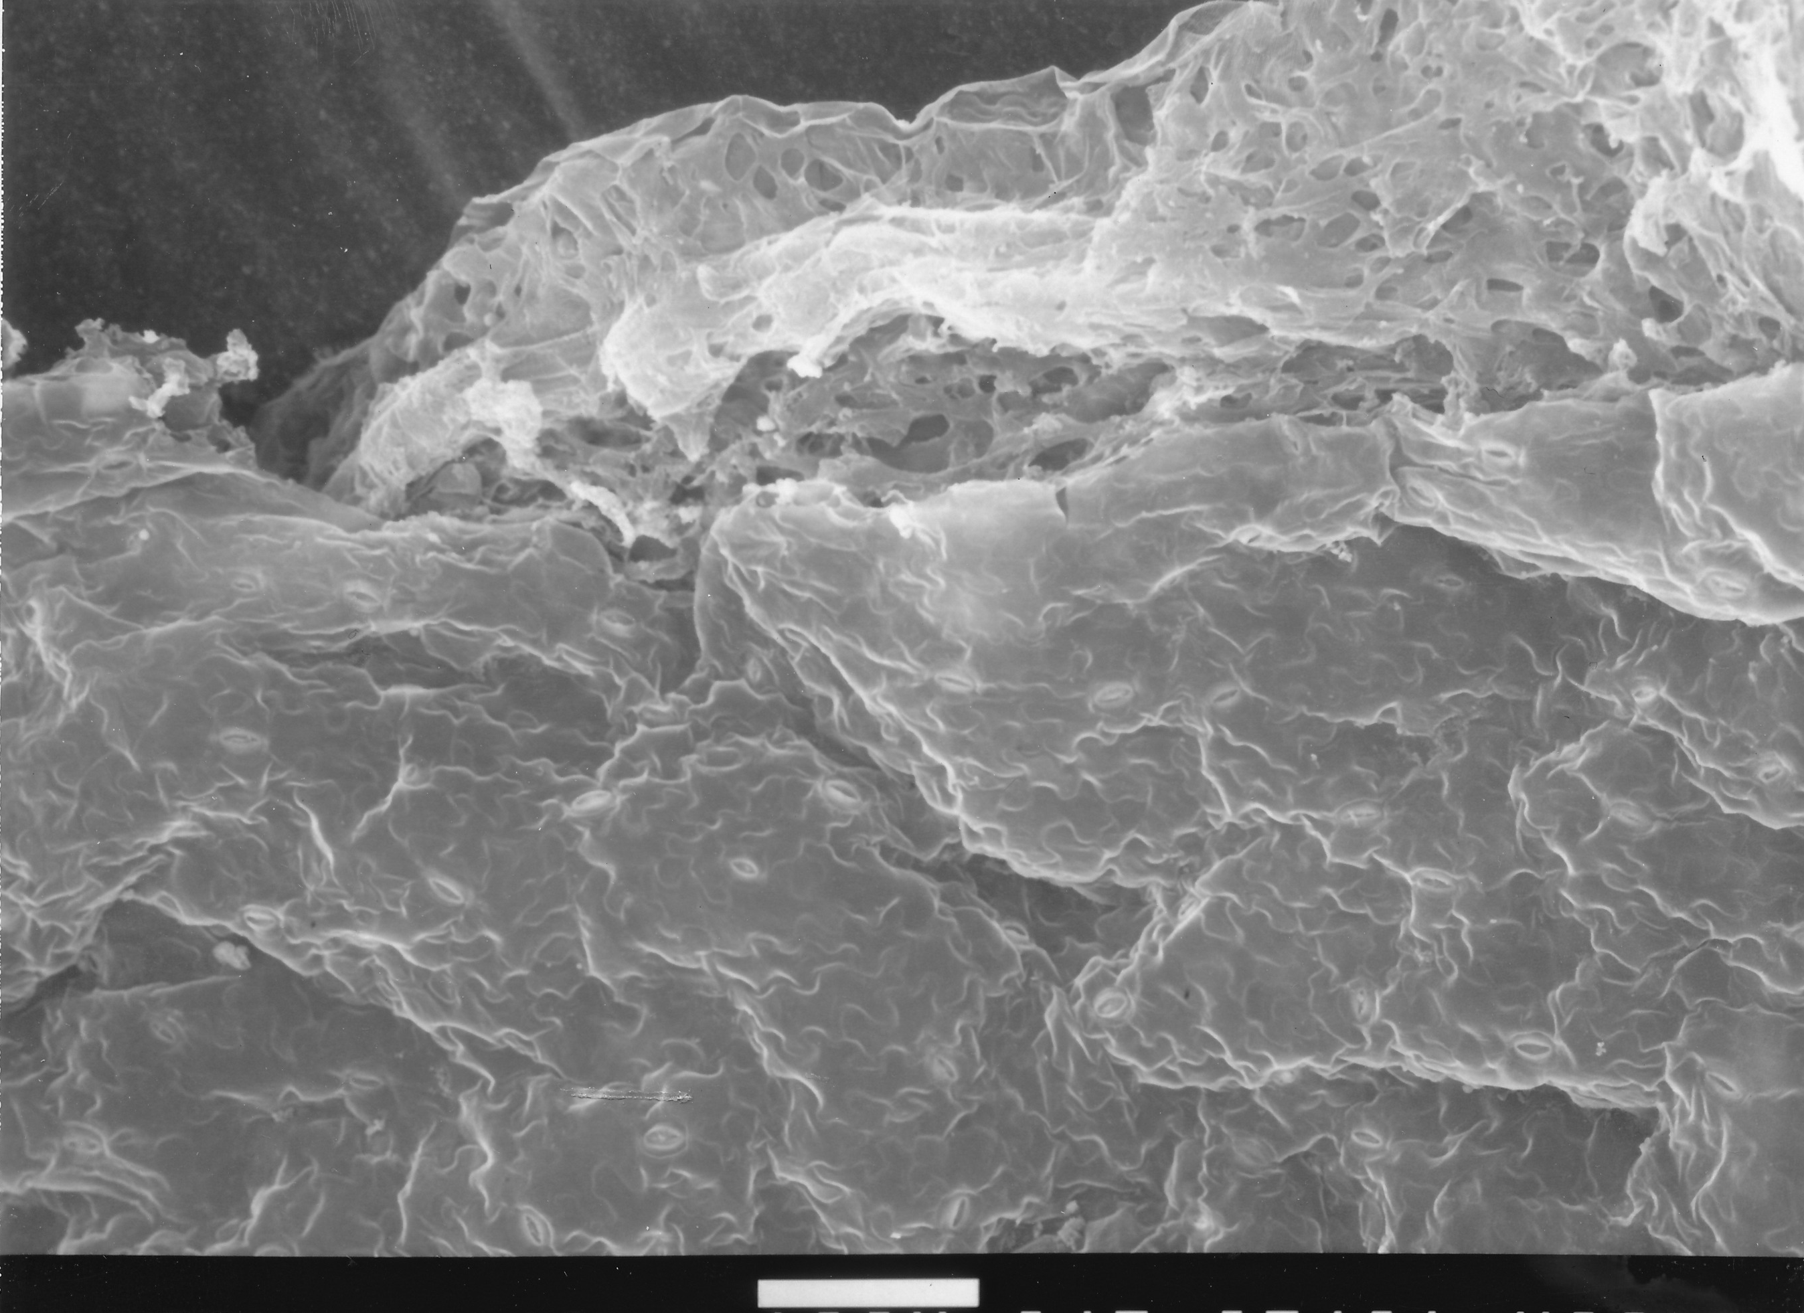
100 µm
Notes:
286. Lettuce, green. SEM of epidermal surface. Stomate (arrow). Courtesy of Dr. Meredith A. Lane.

Slide 11
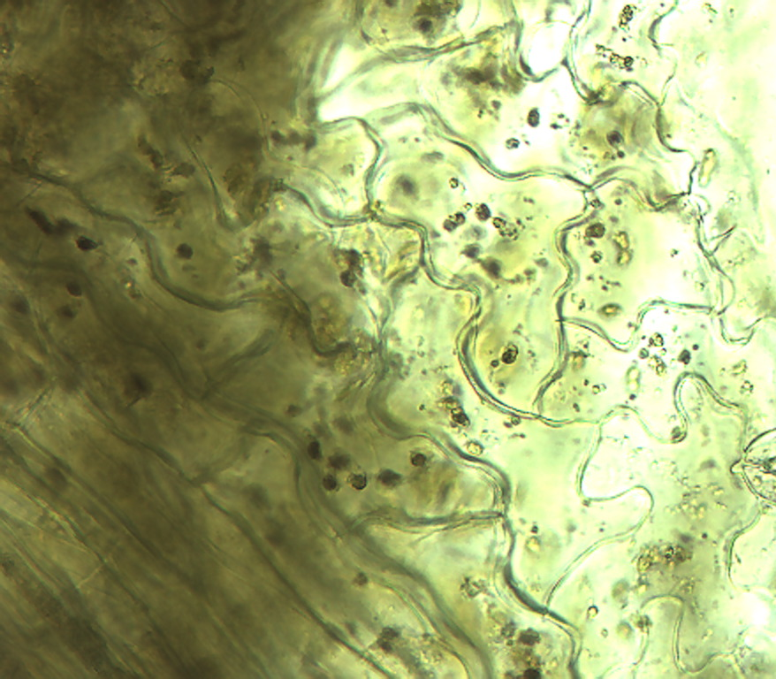
Notes:
287. . Lactuca spp. L. Lettuce, red (many varieties). Leaf epidermal cells, 25X.

Slide 12
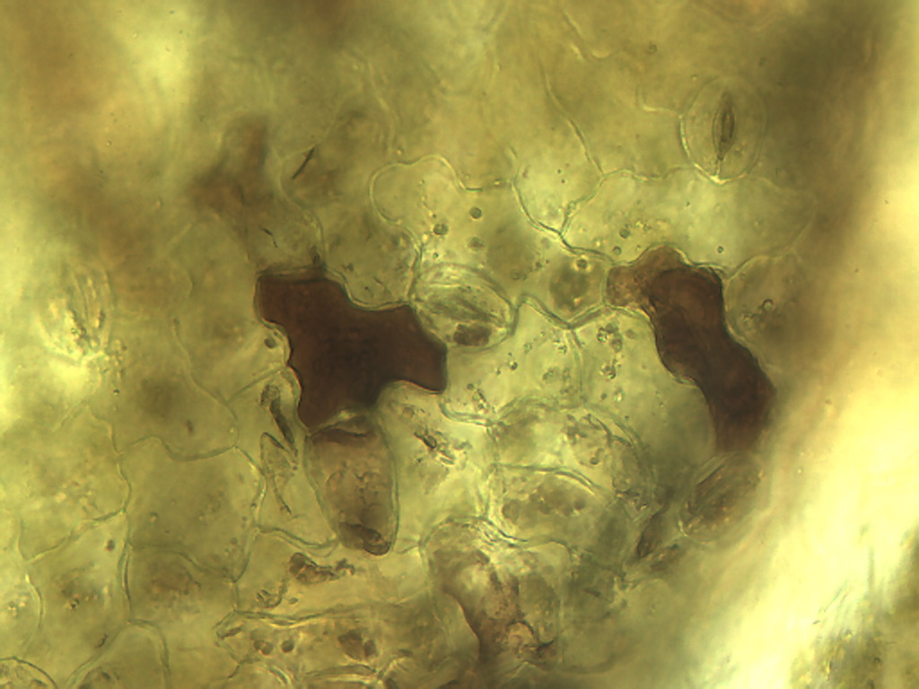
Notes:
288. Lettuce, red. Leaf epidermal cells containing anthocyanin (arrows), a reddish pigment, 25X.

Slide 13
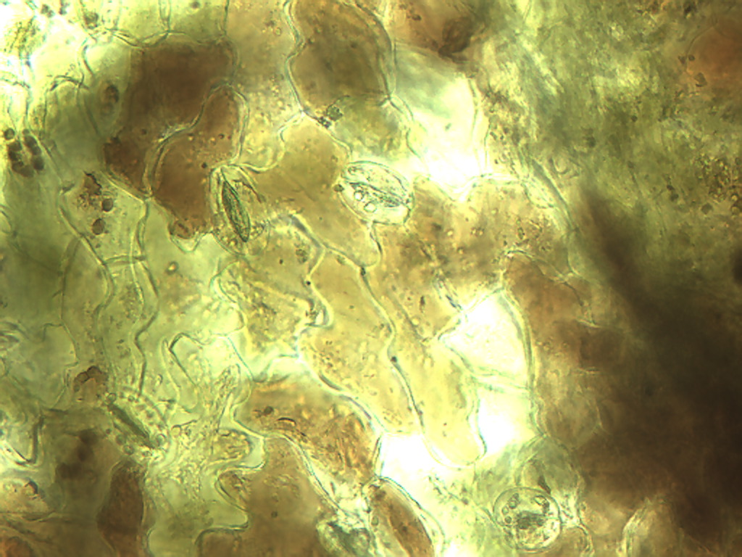
Notes:
289. Lettuce, red. Leaf epidermal cells containing various amounts of anthocyanin, a reddish pigment, 25X.

Slide 14
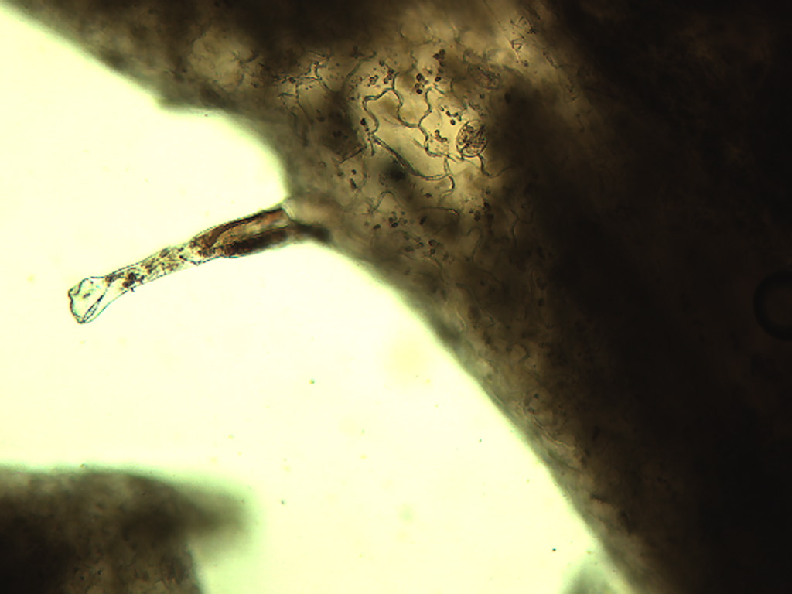
Notes:
290. Lettuce, red. Leaf epidermis with trichome projecting outward, 10X.

Slide 15
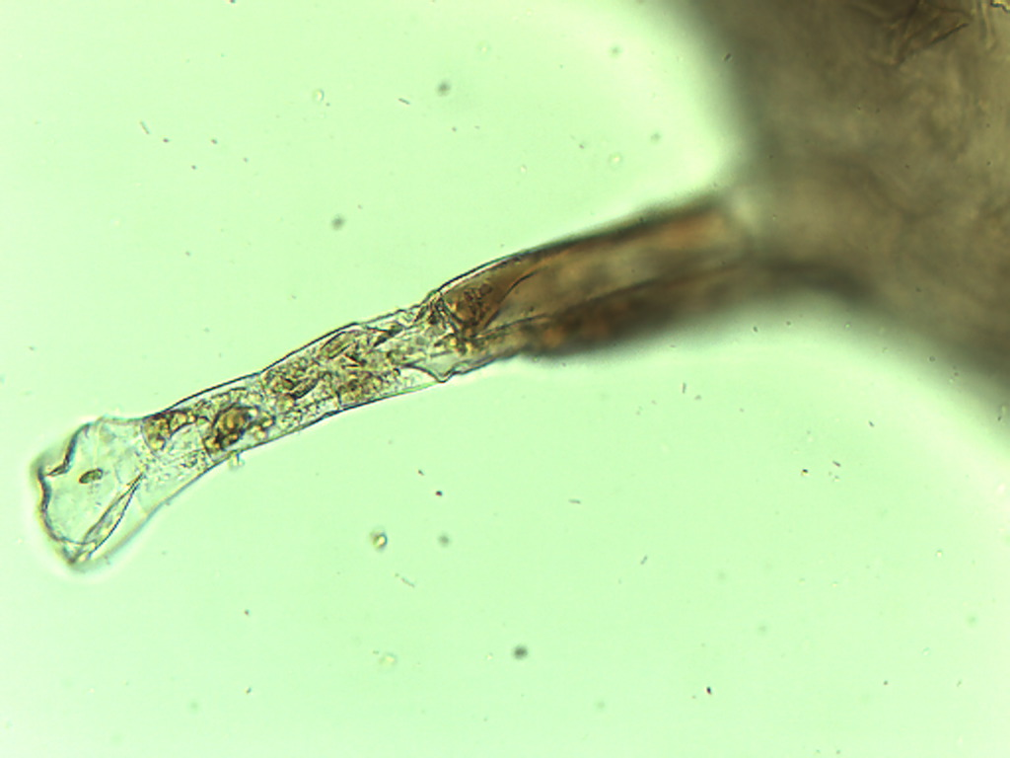
Notes:
291. Lettuce, red. Epidermal trichome on leaf, 25X.

Slide 16
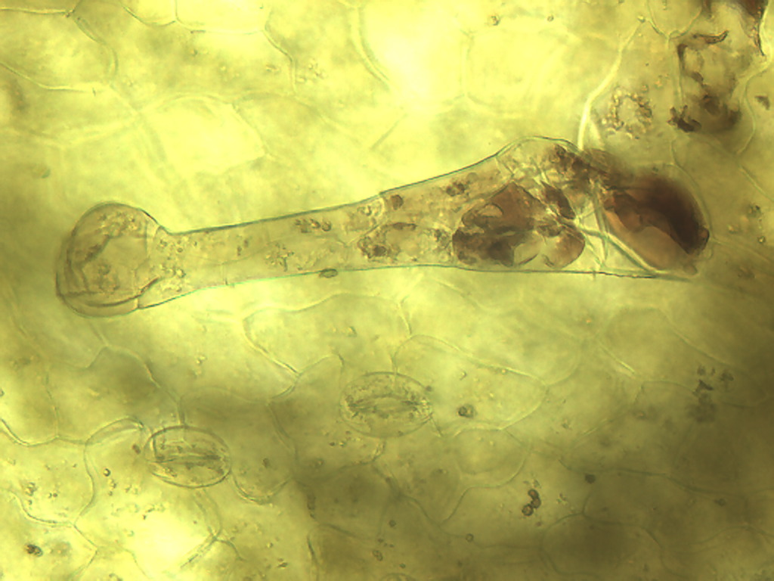
Notes:
292. Lettuce, red. Epidermal trichome on leaf, 25X

Slide 17
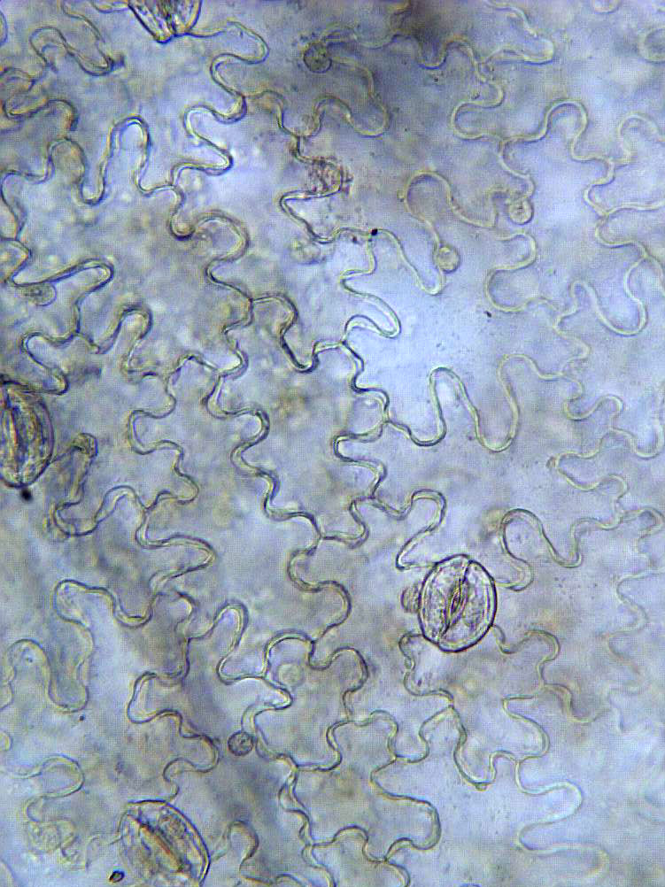
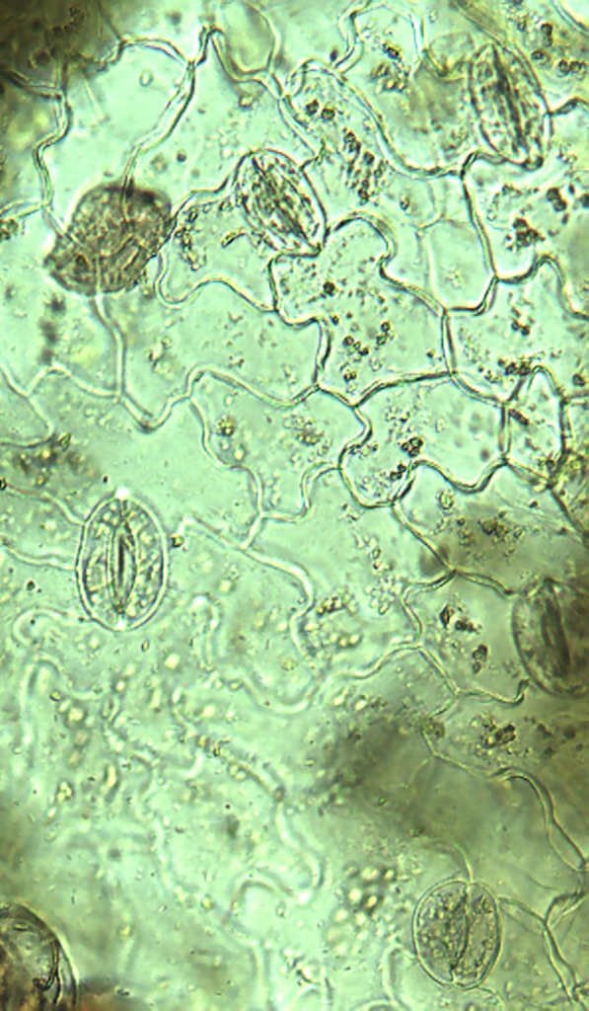
A
B
Notes:
293. Lettuce: Green and Red. Comparison of epithelial cells and stomate complex (arrow) of red (A) and green (B) leaf lettuce, 25X

Slide 18
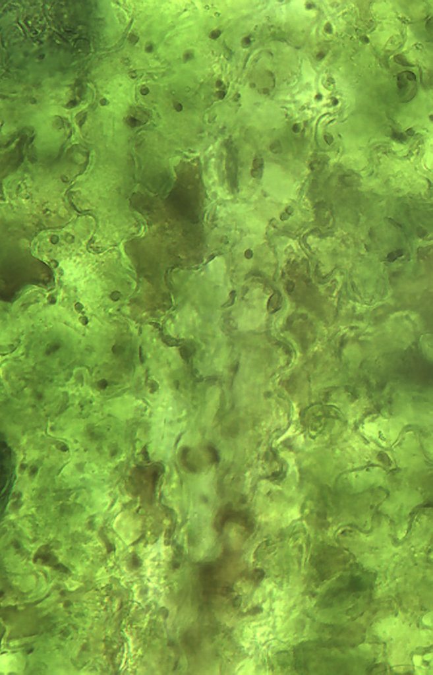
Notes:
294. Lettuce: Green and Red. (A). red; epidermal cell (arrow) containing large amount of anthocyanin, a reddish pigment, 25X. (B). Similar pigmented cells (arrow) in green lettuce are uncommon, 25X

